Slide 1
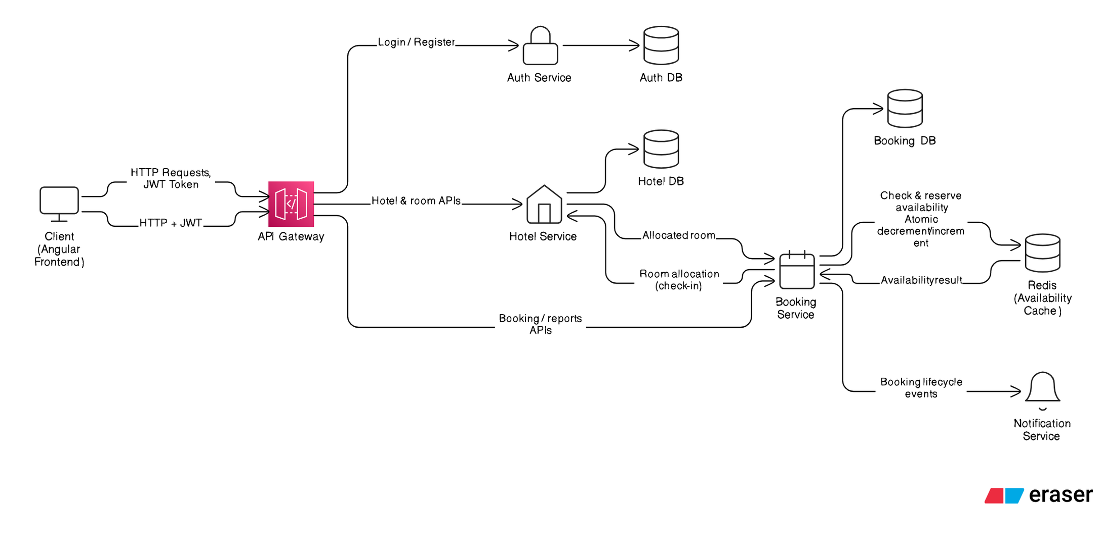
Hotel Management System

Slide 2
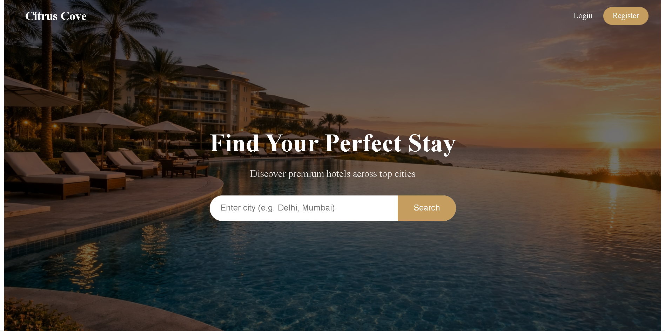

Hotel Management System

Slide 3

CHAPTER 1
System Bootstrap & Infrastructure Initialization
01
02
Config Server Initialization
Service Configuration Fetch
Central configuration authority starts and becomes available for all services
Each microservice retrieves environment-specific settings from Config Server
03
04
Eureka Registration
Heartbeat Mechanism
Services register themselves with Eureka Service Registry for dynamic discovery
Periodic health checks ensure only live instances remain in the registry

Slide 4
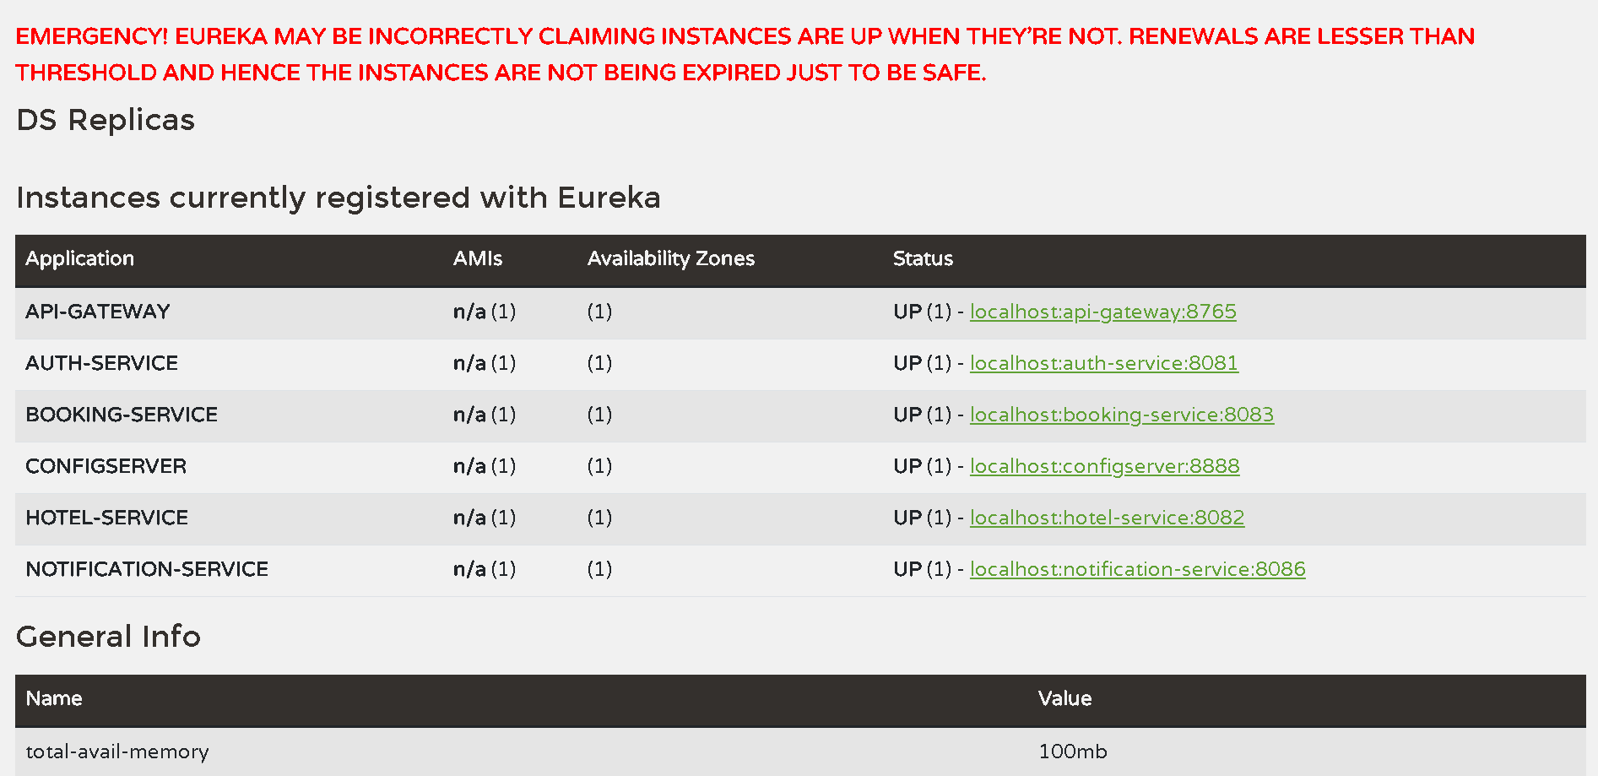

CHAPTER 1
01
02
Config Server Initialization
Service Configuration Fetch
Central configuration authority starts and becomes available for all services
Each microservice retrieves environment-specific settings from Config Server
03
04
Eureka Registration
Heartbeat Mechanism
Services register themselves with Eureka Service Registry for dynamic discovery
Periodic health checks ensure only live instances remain in the registry

Slide 5

CHAPTER 2
API Gateway Flow
Single Entry Point for External Requests
The API Gateway serves as the sole external entry point to the backend infrastructure. As a Eureka client, it dynamically discovers downstream services without hardcoded URLs. The gateway handles security, routing, and service isolation while remaining free of business logic.
1
JWT Token Validation
All internal microservices are protected from direct external access, creating a secure perimeter around the system architecture.
Verify token authenticity and expiry
2
Identity Extraction
Extract user ID and role claims
3
Role-Based Checks
Enforce route-level permissions
4
Service Resolution
Discover target service via Eureka
5
Request Forwarding
Route to destination microservice

Slide 6


CHAPTER 3
Authentication Flow
Security Backbone of the System
Credential Validation
JWT Token Generation
Role-Based Access
User credentials validated against Auth DB using secure BCrypt password hashing for maximum security
Stateless token issued containing userId, role, and expiry timestamp for cross-service authentication
Four distinct roles enforced: ADMIN, MANAGER, RECEPTIONIST, GUEST with service-level validation
Defense-in-Depth Strategy: The Auth Service is the only component that stores or validates credentials directly. Every subsequent request is authenticated using JWT tokens, keeping downstream services completely stateless. Role enforcement occurs at multiple layers for maximum security.

Slide 7




CHAPTER 4
Hotel Service Flow
Static Inventory Authority
The Hotel Service owns all static and structural data related to hotels, acting as the single source of truth for room inventory. No other service directly mutates hotel data, ensuring data consistency and clear ownership boundaries.
Hotel Management
Room Categories
Physical Rooms
Complete hotel entity management including properties, locations, and configurations
Category definitions with pricing, capacity, and amenity specifications
Individual room tracking with status management and maintenance scheduling
AVAILABLE
OCCUPIED
MAINTENANCE
Ready for booking and guest check-in
Currently hosting a checked-in guest
Under repair or cleaning, unavailable
Room status transitions occur exclusively during check-in and check-out operations initiated by the Booking Service, maintaining strict state management and preventing unauthorized status changes.

Slide 8








CHAPTER 5
Booking Service Core Flow
Heart of the Transactional System
The Booking Service represents the core transactional engine of the entire platform. It owns all time-based and transactional data, serving as the authoritative source for reservations, analytics, and financial reporting. All stay timelines and revenue data flow through this critical service.
Booking Creation
Lifecycle Management
Availability Control
Handle new reservation requests with validation, pricing calculation, and initial state assignment
Enforce state transitions through BOOKED → CONFIRMED → CHECKED_IN → CHECKED_OUT flow
Coordinate with Redis to prevent overbooking and manage concurrent reservation requests
Check-In/Check-Out
Billing Engine
Reporting Hub
Orchestrate room allocation and release with Hotel Service during guest arrival and departure
Calculate charges, process payments, and generate final invoices based on stay duration
Provide occupancy rates, revenue metrics, and booking trends from authoritative data store
Event Production
Publish booking lifecycle events to RabbitMQ for asynchronous downstream processing

Slide 9






CHAPTER 6
Redis Availability & Concurrency Control
Preventing Race Conditions at Scale
Redis serves as a derived state store for real-time availability management. When booking requests arrive, the Booking Service queries Redis for availability using atomic operations to check and lock resources simultaneously.
If availability exists, Redis decrements the count atomically. The booking persists to the Booking DB, and only then is the transaction complete. If any step fails, Redis performs a rollback to maintain consistency.
Query Redis
Atomic Lock
Check availability for hotel, category, and date range
Reserve room count with atomic decrement operation
Persist Booking
Commit or Rollback
Save confirmed booking to Booking DB
Finalize or revert Redis state based on DB result
Performance Advantage: Redis prevents expensive overlap queries on the Booking DB during concurrent bookings. It never stores booking or billing data and can be completely rebuilt from the Booking DB if needed, making it a pure performance optimization layer.

Slide 10

CHAPTER 7
Booking Lifecycle & Receptionist Operations
State Enforcement
Check-In Flow
Each booking follows a strictly enforced lifecycle within the Booking Service. Invalid state transitions are rejected at the service layer, guaranteeing data consistency regardless of frontend behavior or concurrent requests.
Receptionist provides booking reference
Booking Service validates booking status
BOOKED
Booking Service calls Hotel Service to allocate physical room
Initial reservation created
Hotel Service marks room as OCCUPIED
Booking status updated to CHECKED_IN
CONFIRMED
Optional payment verification
Redis availability adjusted if needed
Check-Out Flow
CHECKED_IN
Booking Service calculates total stay duration
Guest arrival, room assigned
Final bill computed based on duration and rate
CHECKED_OUT
Booking marked as CHECKED_OUT
Stay complete, room released
Hotel Service releases room to AVAILABLE
Redis availability incremented for future bookings

Slide 11






CHAPTER 8
Event-Driven Communication
Asynchronous Processing with RabbitMQ
The system leverages RabbitMQ for asynchronous, event-driven communication between services. The Booking Service acts as the event producer while the Notification Service consumes these events. This architecture ensures loose coupling and prevents notification failures from impacting core booking transactions.
Events Produced by Booking Service
Notification Service Flow
BOOKING_CREATED
The Notification Service listens to RabbitMQ queues bound to booking events. When an event is consumed, notification content is generated and delivered via email or messaging platforms.
New reservation successfully created in the system
01
BOOKING_CONFIRMED
Event Reception
Payment verified and booking status confirmed
Consume message from RabbitMQ queue
02
BOOKING_CANCELLED
Content Generation
Reservation cancelled by user or system
Build personalized notification message
03
CHECK_IN_COMPLETED
Delivery Attempt
Guest arrival processed, room assigned
Send email or message to user
CHECK_OUT_COMPLETED
04
Failure Handling
Guest departure processed, final bill generated
Log errors and retry if configured
Critical Design Principle: Notification failures never rollback booking transactions. This ensures reliability and maintains loose coupling between transactional and communication layers.

Slide 12





SUMMARY
Overall Summary
Dynamic Service Discovery
Event-Driven Design
Eureka enables automatic service resolution without hardcoded URLs
RabbitMQ provides asynchronous, loosely-coupled communication
Race-Condition Safe
Clear Separation
Bootstrap
Redis atomic operations prevent concurrent booking conflicts
Each service owns specific data and business logic domains
1
Config Server → Eureka registration
2
Request Entry
API Gateway → JWT validation
Service Routing
3
Eureka discovery → Target service
4
Business Logic
Redis coordination → DB commit
Event Publishing
5
RabbitMQ → Notification delivery
The Scheduler runs independently for daily reminders, ensuring system-driven communications remain reliable even without user interaction. All reporting executes directly from the Booking DB using optimized read-only queries, eliminating the need for a separate reporting microservice.

Slide 13
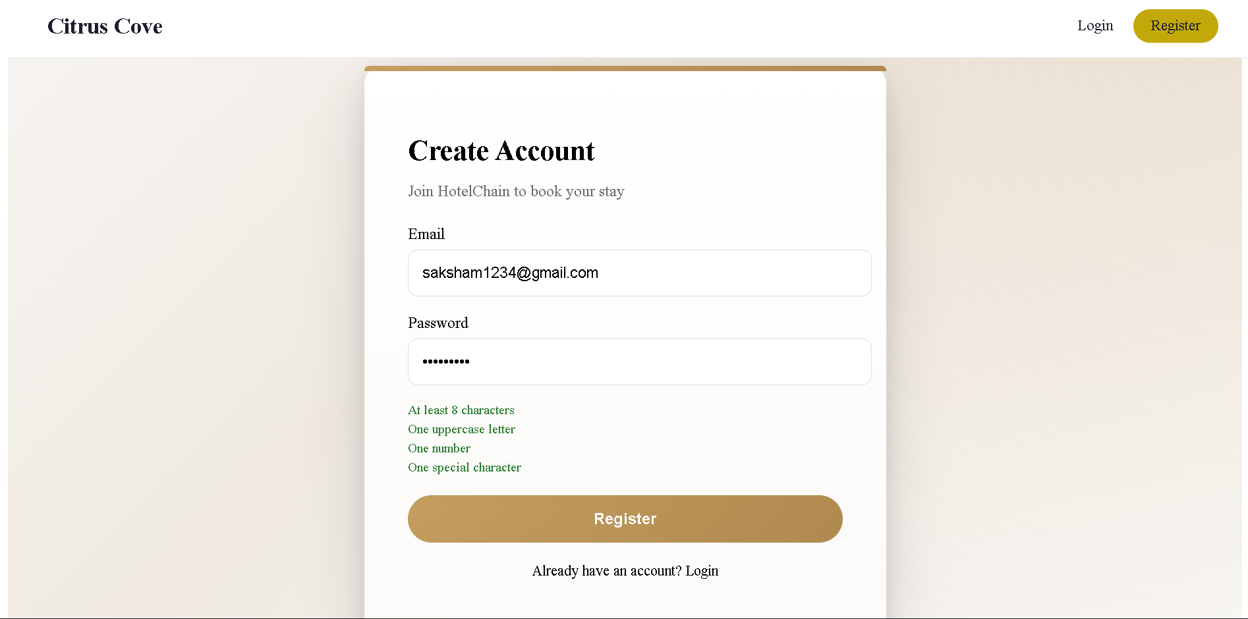
Frontend Screens :-

Slide 14
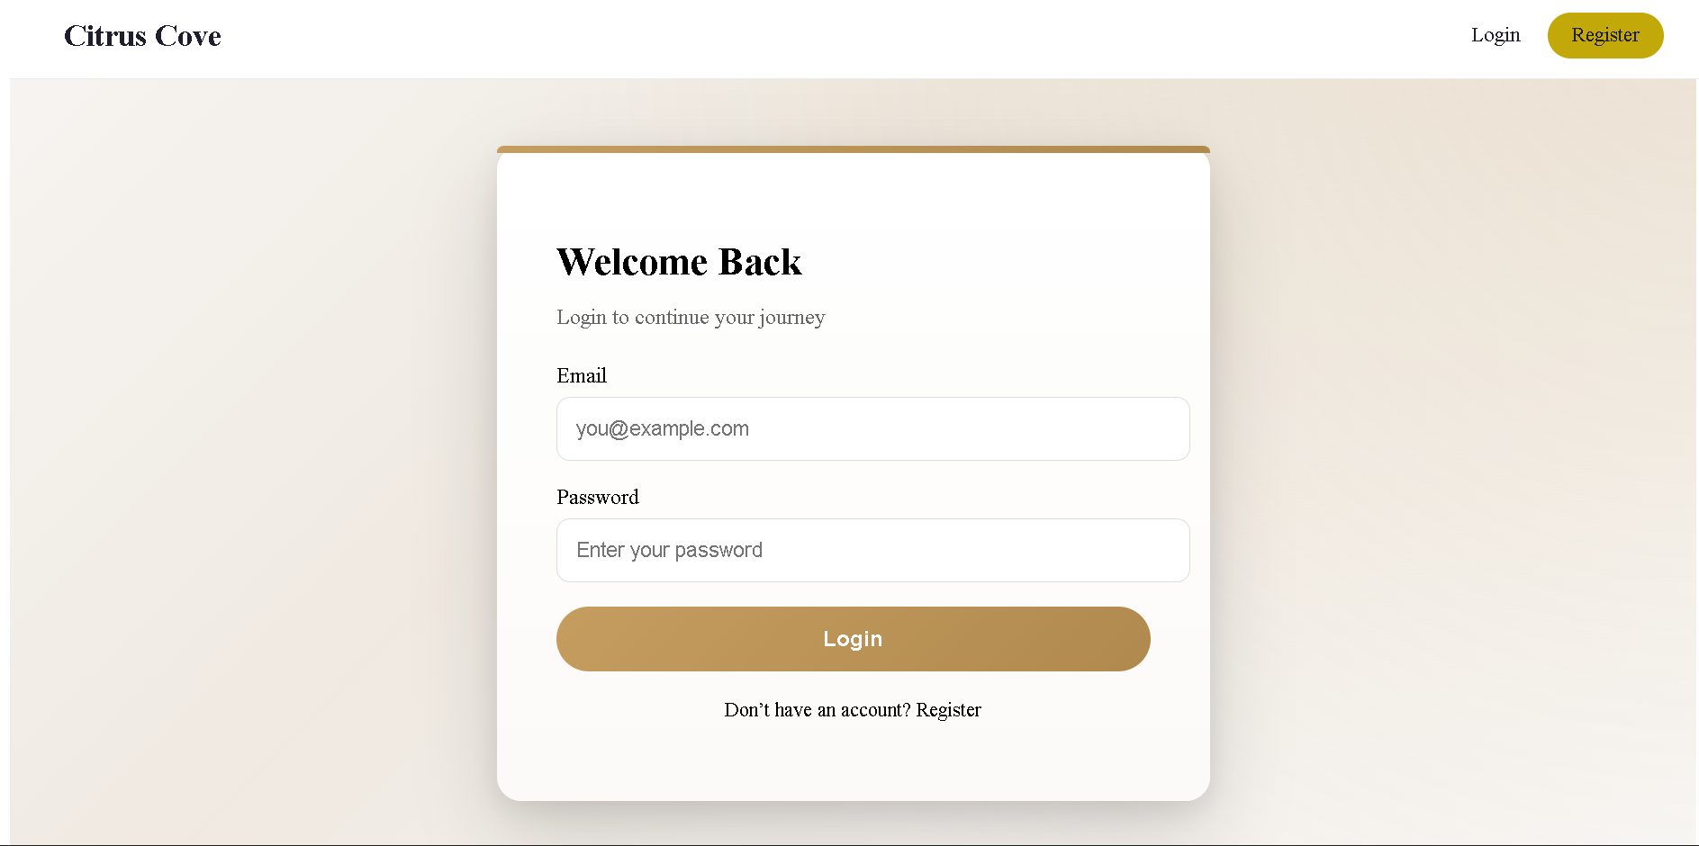

Slide 15
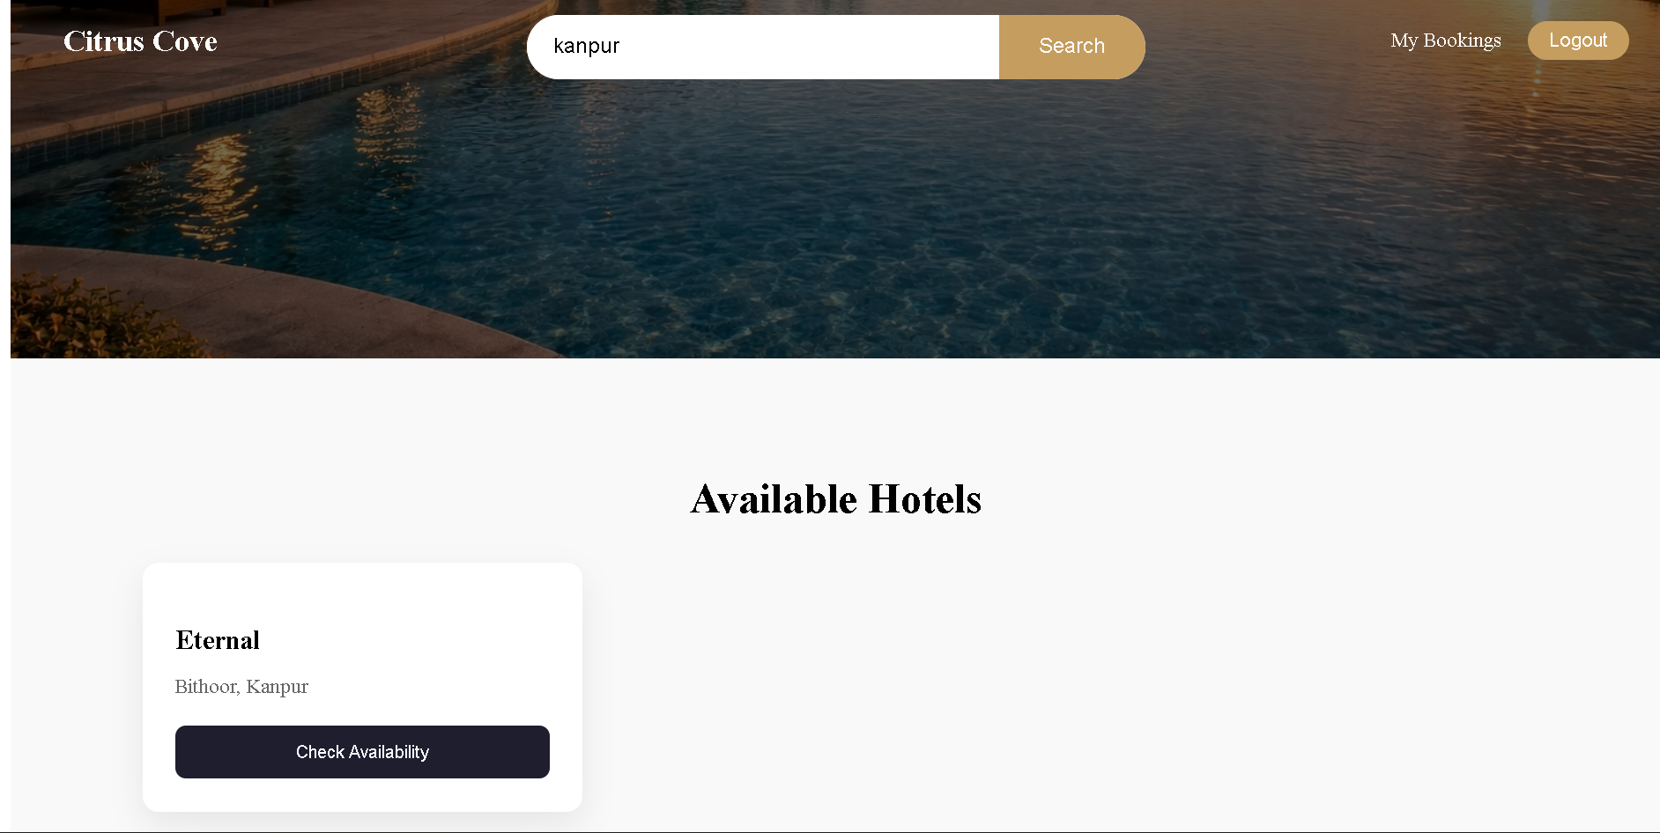

Slide 16
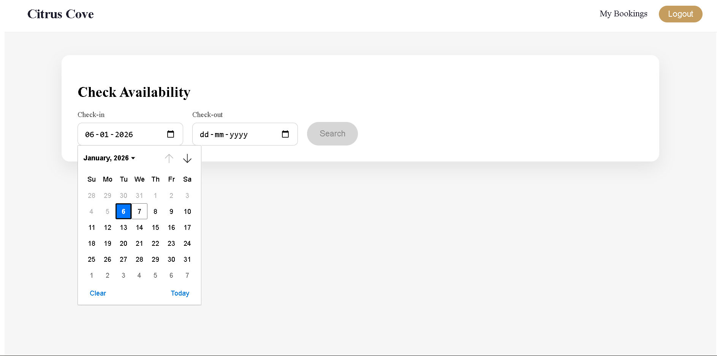

Slide 17
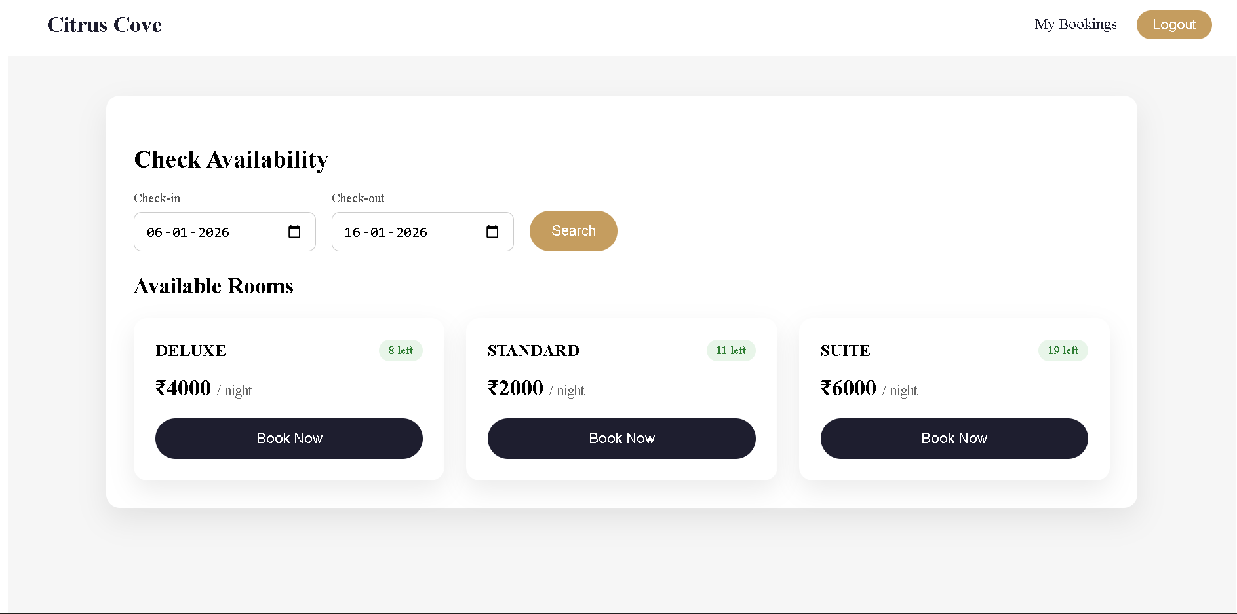

Slide 18
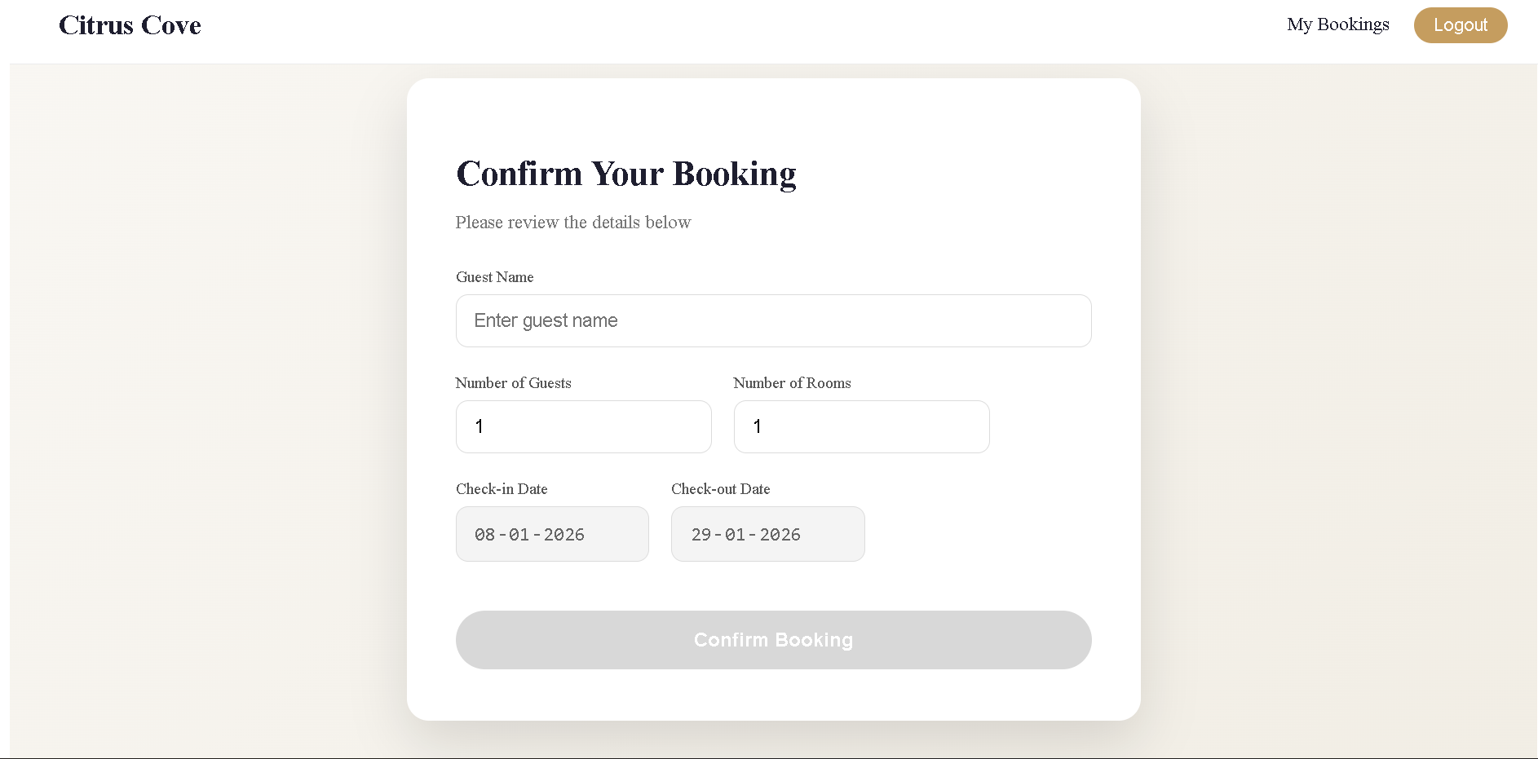

Slide 19
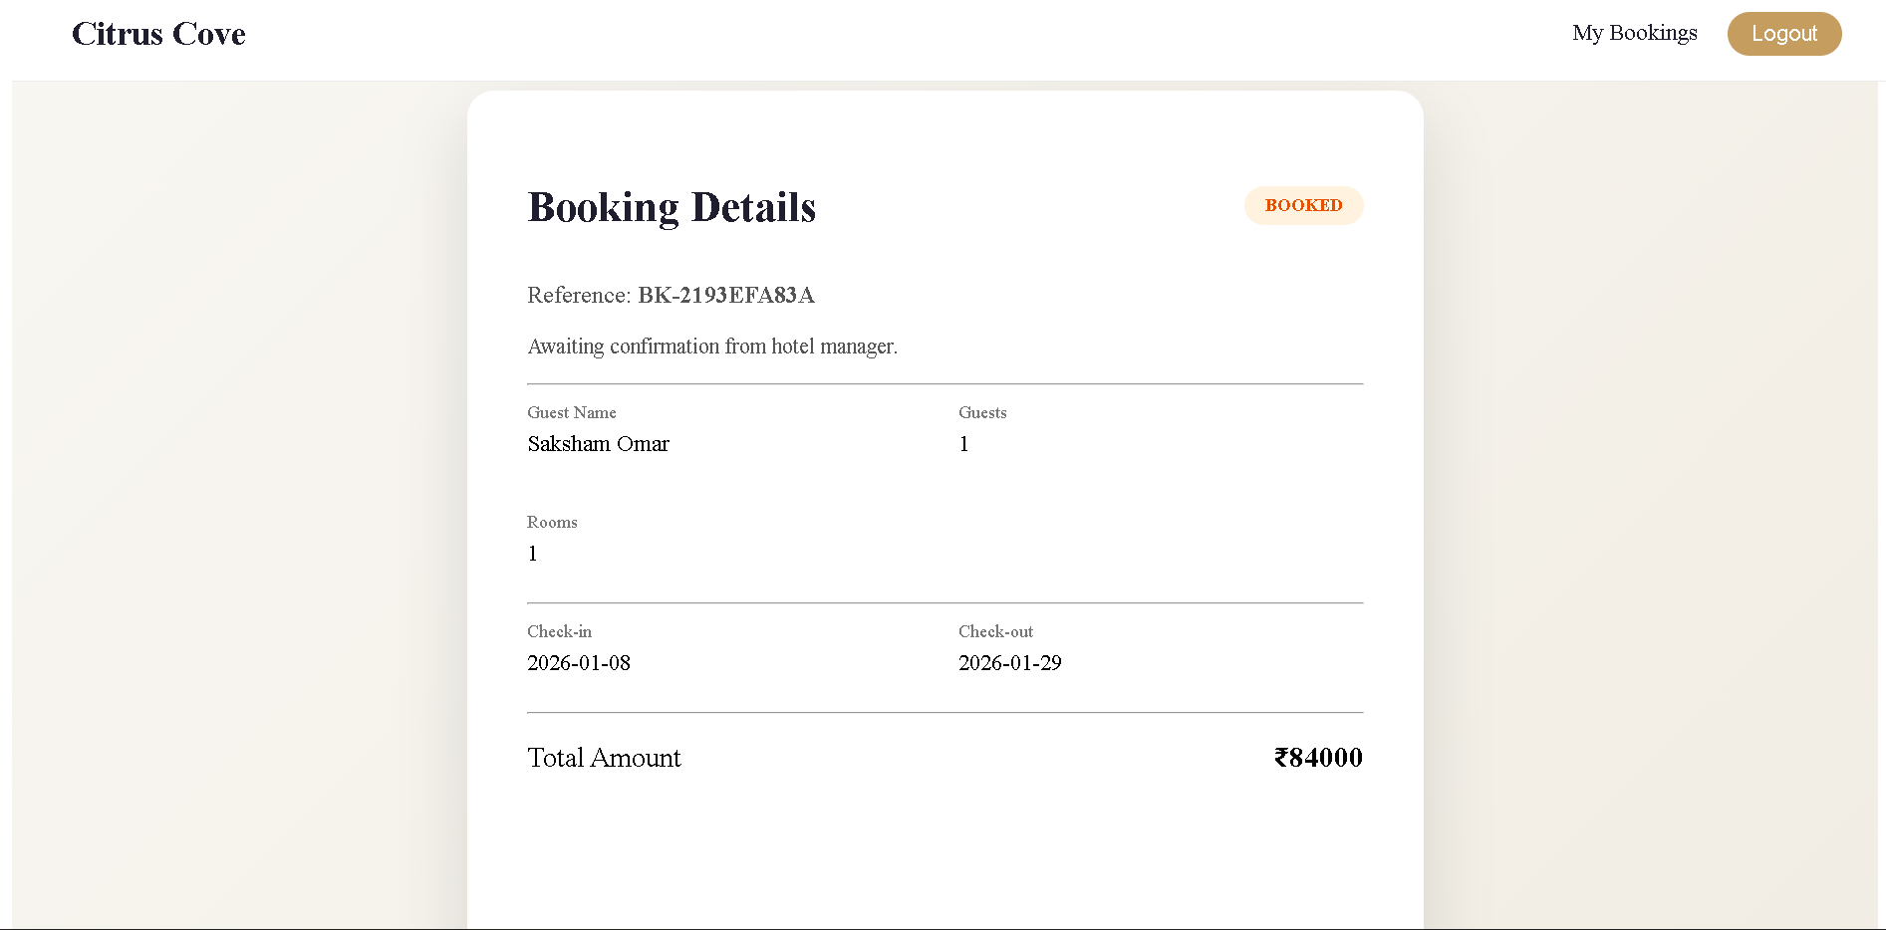

Slide 20
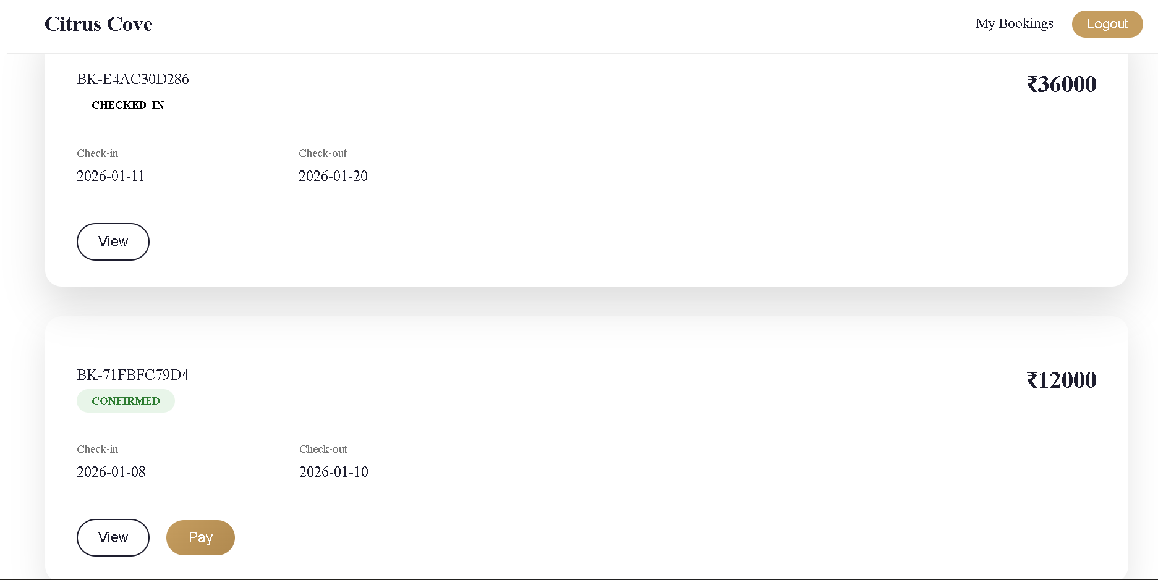

Slide 21
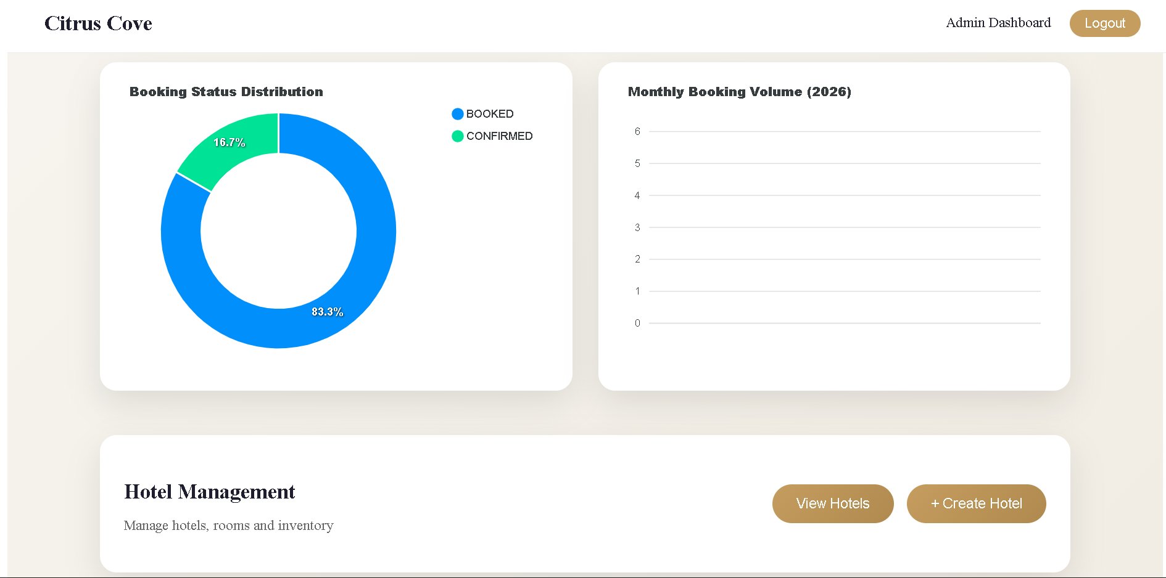

Slide 22
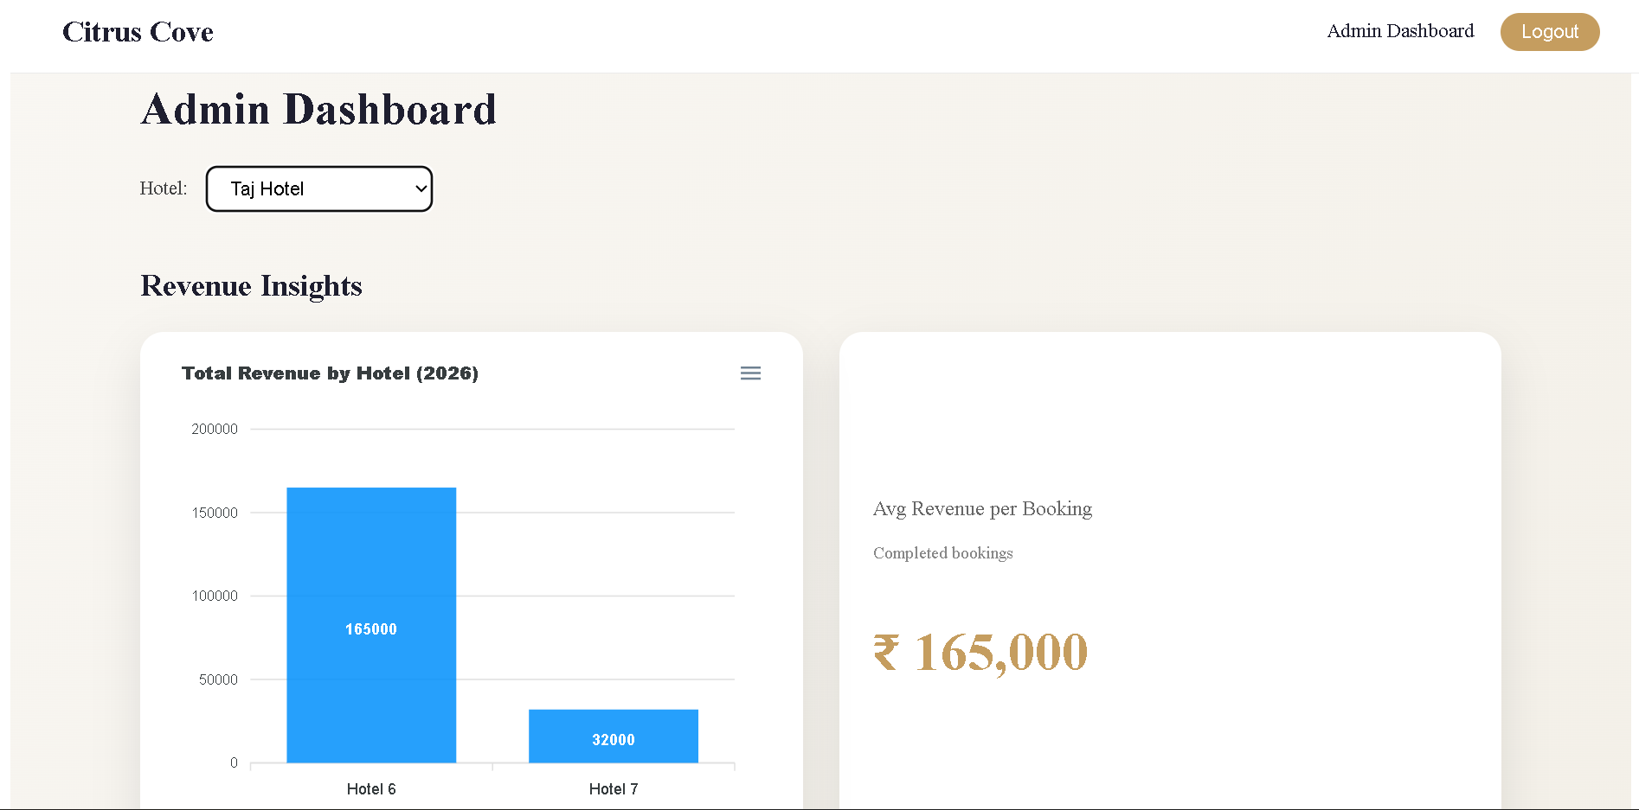

Slide 23
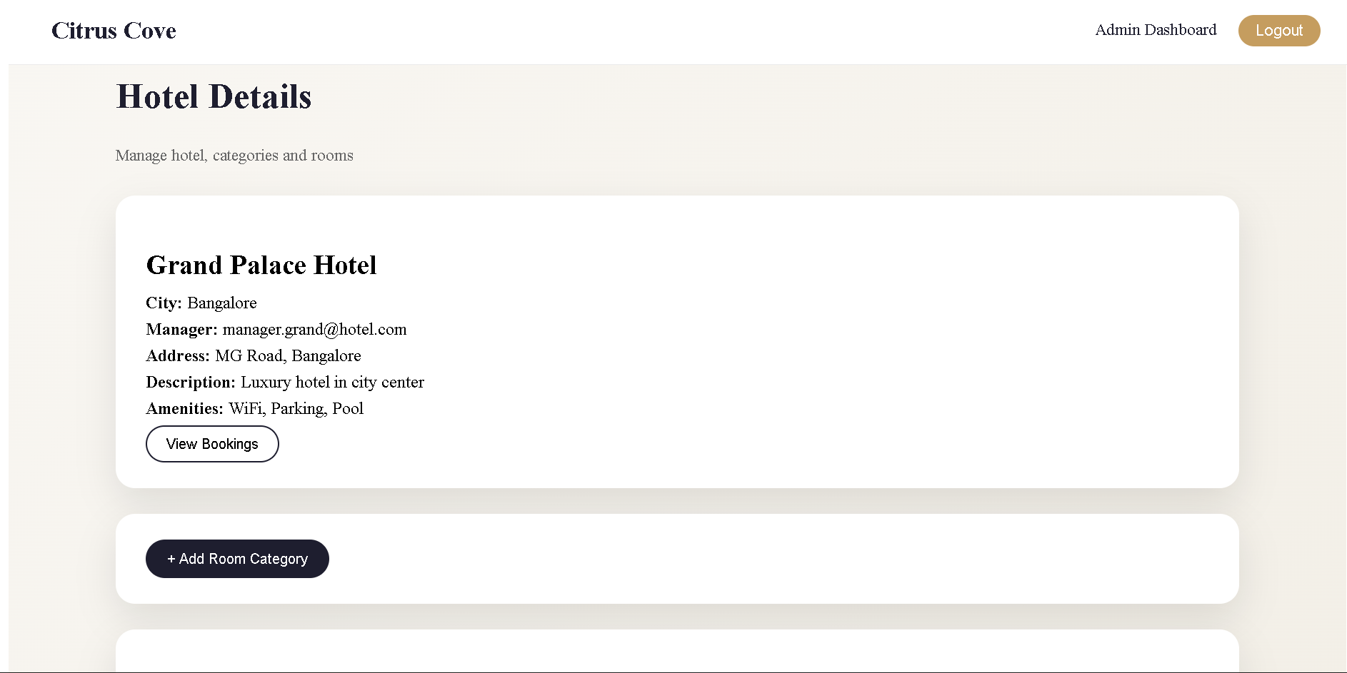

Slide 24
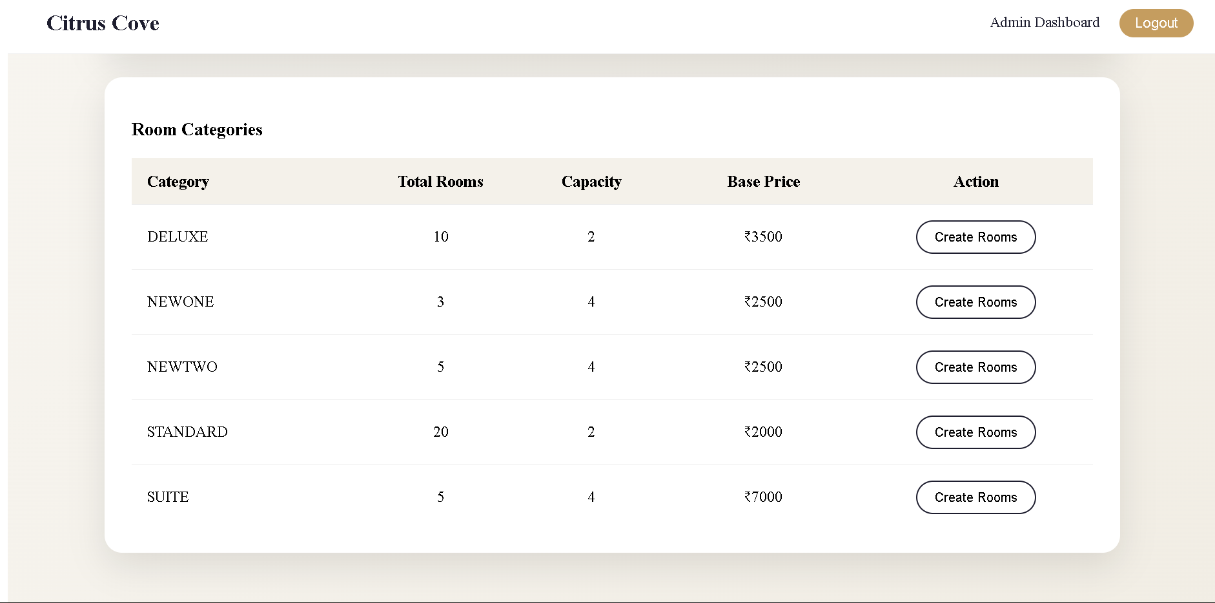

Slide 25
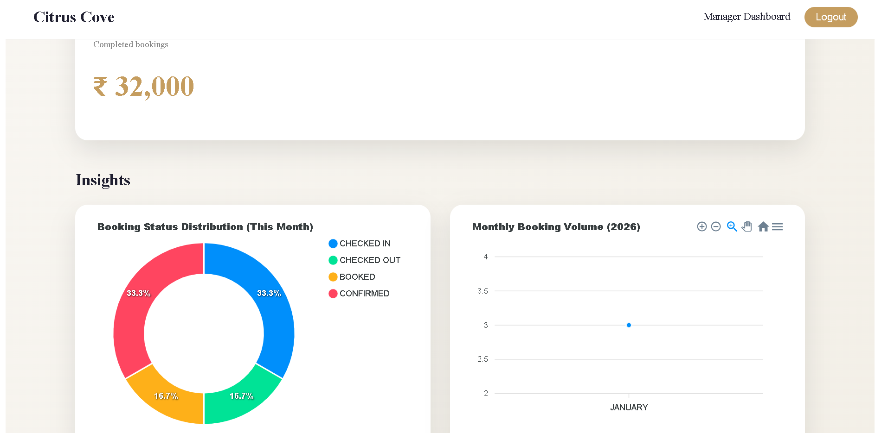

Slide 26
